Slide 1
Lecture 8a: Modules, Modular and C Programming

Slide 2
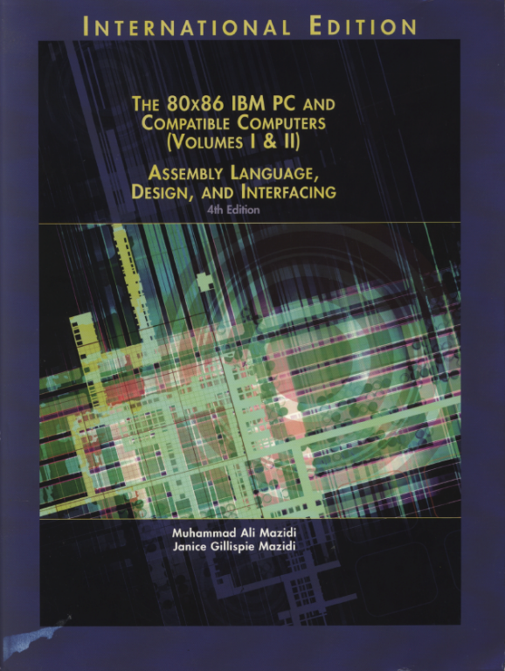
Reference Book:
The 80x86 IBM PC and Compatible Computers
Chapter 7
Modules, Modular and C Programming

Slide 3
Why Modules?
Each module can be written, debugged and tested individually
Without modules, if one subroutine did not work properly, the entire program would have to be rewritten and reassembled.
The Failure of one module does not stop the entire project
The task of locating and isolating any problem is easier.
One can use the modules to link with high-level Language such as C, Pascal, or BASIC.
Parallel development shortens considerably the time required to complete a project.
Notes:
可以将全部的模块用汇编语言编写，各自测试通过后连接；
也可以把汇编编写的模块与C等高级语言编写的模块一起连接。
可以提高程序开发的速度

Slide 4
Writing Modules
A more efficient way to develop a software is to treat each subroutine as a separate program (or module) with a separate filename.
Assemble and test each module
Link all modules together as all modules passed tests.
Notes:
1. 可以把每个子程序都用一个单独的文件存储、汇编和测试，最后做连接。

Slide 5
Modular Programming Directives
EXTERN directives
Format:
EXTRN name1:type
EXTRN name1:type, name2:type, ……
Notify the assembler and linker that certain names and variables which are not defined in the present module are defined externally somewhere else.
External procedure name can be NEAR, FAR, or PROC
Data type can be BYTE(1), WORD(2), DWORD(4), FWORD(6), QWORD(8), or TBYTE(10).
Notes:
EXTERN伪指令指示汇编程序和连接程序所定义的名字没有在本模块中定义
该名字可以是变量名字（要告知类型），也可以是程序或者是过程的名字（要定义NEAR或者FAR）

Slide 6
Modular Programming Directives
PUBLIC directives
Format:
PUBLIC name1
PUBLIC name1, name2, ……
Those names or parameters defined as EXTRN mush be defined as PUBLIC in the module where they are defined.
Allows the assembler and linker to match it with its EXTRN counterparts(s).
Notes:
1. 指示所定义的名字要成为全局可见，让其它模块可以调用

Slide 7
Modular Programming Directives
END directives
Format:
END Label
Notice the entry and exit points of the program (Main Program)
Modules that are called have the END directive with no labels after them.
Notes:
END后跟随标号的话就告诉连接程序该标号为程序的入口点
定义子程序的文件在最后需要加上END伪指令，并且该伪指令后不可以跟随标号。

Slide 8
Directive Examples
;1st source code file
;===================
EXTRN SUBPROG1:FAR
EXTRN SUBPROG2:FAR
.MODEL SMALL
.CODE
MAIN PROC FAR
…
CALL SUBPROG1;
CALL SUBPROG2;
…
MAIN ENDP
END MAIN;
;2nd source code file
;==================
PUBLIC SUBPROG1
.MODEL SMALL
.CODE
SUBPROG1 PROC FAR
…
RET
SUBPROG1 ENDP
END;
;3rd source code file
;==================
PUBLIC SUBPROG2
.MODEL SMALL
.CODE
SUBPROG2 PROC FAR
…
RET
SUBPROG2 ENDP
END;
Notes:
第一个为主程序；后二个为子程序。要注意伪指令的定义关系和一致性

Slide 9
Linking Modules Together
Use link command to bring all the OBJ files together.
Format:
C:>LINK EXAMPLE1.OBJ+PROG1.OBJ+PROG2.OBJ
Entry point is indicated by “END Lable”

Slide 10
SEGMENT Directive
If only one of each segment of code, data and stack
Normally we use simplified format:
Name SEGMENT
In the case there are many modules to be linked together, the full segment definition has to be used.

Slide 11
SEGMENT Directive
If multiple of segment of code, data and stack
Format:
Name SEGMENT alignment combine_type class_name
Alignment: indicate the segment boundary start from
BYTE, WORD, or PARA (16-byte boundary)
Combine_type: indicate the linker whether segments of the same type should be linked together
Typical option: STACK, PUBLIC
Class_name: the class of the segment, used in combining segments of the same type from various modules.
Options: ‘CODE’, ‘STACK’, ‘DATA’, and ‘EXTRA’

Slide 12
SEGMENT Directive
Complete stack segment definition
Example:
Name SEGMENT PARA STACK ‘STACK’
Complete data and code segment definitions
Example:
name SEGMENT PARA ‘DATA’ ; If no other module has ; defined any segment
name SEGMENT PARA PUBLIC ‘CODE’ ; in the case any other module ; has defined a code segment
name SEGMENT PARA PUBLIC ‘DATA’ ; in the case any other module
; has defined a data segment

Slide 13
Directive Examples
;1st source code file
;===================
STSEG SEGMENT PARA STACK ‘STACK’
……
STSEG ENDS
DTSEG SEGMENT PARA ‘DATA’
……
DTSEG ENDS
CODSG_A SEGMENT PATA ‘CODE’
MAIN PROC FAR
……
MAIN ENDP
CODSG_A ENDS
END MAIN
;2nd source code file
;==================
CODSG_B SEGMENT PATA ‘CODE’
SUBPROG1 PROC FAR
……
SUBPROG1 ENDP
CODSG_B ENDS
END;
;3rd source code
;==================
CODSG_C SEGMENT PATA ‘CODE’
SUBPROG2 PROC FAR
……
SUBPROG2 ENDP
CODSG_C ENDS
END;
Notes:
要用放大镜显示各个程序

Slide 14
Merge SEGMENTs
Assembled SEGMENT with PARA
Start Stop Length Name Class
00000H 00063H 00064H STSEG STACK
00070H 0007BH 0000CH DTSEG DATA
00080H 00092H 00013H CODSG_A CODE
000A0H 000B5H 00016H CODSG_B CODE
000C0H 000D0H 00011H CODSG_C CODE
Linked SEGMENT with WORD
Start Stop Length Name Class
00000H 00063H 00064H STSEG STACK
00064H 0006FH 0000CH DTSEG DATA
00070H 000AAH 0003BH CDSEG CODE

Slide 15
PASSING PARAMETERS in ASM
Passing parameters among ASM modules, or ASM between BASIC, Pascal, or C.
Via register
Use CPU’s register, INT 21H DOS service for example.
Via memory
There must be a universal agreement to the addres of the memory, this sind of standardization is hard to come by.
Via the stack
1) Caller stored parameters on the stack
2) Callee gets the operands from the stack.
3) Callee stored the return via registers, and uses the RET # to returns control to caller and recover the stored parameter space on the stack.
3) Caller gets control and the result in the CPU’s register.

Slide 16
Combining ASM and C
ASM is the fastest language available for a given CPU, it can not be run on different CPUs.
C is portable, is universal among all the various CPUs, making it the dominant language of programmers.
Combining C and ASM takes advantage of C’s portability and ASM’s speed.
Inserting 80x86 assembly code into C, referred to as in-line assembly
C call an external ASM module

Slide 17
Embedded In-line Assembly
Use keyword before each line of in-line code, depends on C complier
Microsoft C use keyword ‘_asm’
Main () {
_asm mov ah, 2
_asm mov bh, 0
}
Borland C use keyword ‘asm’
Main () {
asm mov ah, 2
asm mov bh, 0
}
Use keyword preface a block of in-line code
Borland C and in-line assembly code
Main () {
asm {
mov ah, 2
mov bh, 0
}
}

Slide 18
C calling convention
1) The parameters are passed by value (except for array) to the stack in reverse order of encountering them
2) C save the address to the stack.
Only IP saved if compiled in SMALL or COMPACT memory model, or the procedure is NEAR.
CS and IP (CS first, then IP) saved if compiled in MEDIUM, LARGE, or HUGE memory model, or the procedure is FAR.
3) BP must be saved on the stack and then the parameters must be accessed by the BP register.
4) The last instruction should be RET with no number after it.
5) Any name shared publicly with C must be prefaced with an underscore, and the only the first eight characters of the name was recognized by C.
6) C passes parameters by value except for arrays, which are passed by reference.
If C is compiled in the MEDIUM, LARGE, or HUGE model, use the FAR option for the Assembly procedure; If C is compiled with the SMALL model, use the NEAR option for the Assembly procedure.

Slide 19
C callable ASM module example
extern cursor( int, int);
Main () {
cursor( 15, 12); ); /* IT IS A NEAR CALL TO THE ASM PROCEDURE */
}
C Program
.MODEL SMALL
.CODE
PUBLIC _CURSOR
_CURSOR PROC
PUSH BP ; SAVE THE BP SINCE CONTENTS ARE ALTERED
MOV BP,SP ;
PUSH AX ; PUSH REGS ALTERED BY THIS MODULE
MOV DH, [BP+4] ; GET FIRST PARAMETER (NEAR Call)
MOV DL, [BP+6] ; GET SECOND PARAMETER (NEAR Call)
……
POP AX ; RESTORE REGS
POP BP
RET ; NEAR return
_CURSOR ENDP
END
ASM SUB
Program

Slide 20
How parameters are returned to C
C expects to find the returned value in certain register(s):
If the returned value is a pointer (address),
AX will hold IP if it is NEAR
DX:AX hold CS:IP if it is FAR
If the returned value is a long integer(4 bytes),
DX holds the higher order word
AX holds the lower order word
Register | Size | C Data Type
AL | 1 byte | char, short
AX | 2 bytes | int
DX:AX | 4 bytes | long

Slide 21
C callable ASM module example
extern unsigned long sum( int, int);
Main () {
cursor( 15, 12); /* IT IS A FAR CALL TO THE ASM PROCEDURE */
}
C Program
.MODEL MEDIUM
.CODE
PUBLIC _SUM
_SUM PROC FAR
PUSH BP ; SAVE THE BP SINCE CONTENTS ARE ALTERED
MOV BP,SP ; USE IT AS SP
SUB AX, AX ; AX = 0
MOV DX, AX ; DX = 0
ADD AX, [BP+6] ; ADD FIRST PARAMETER (FAR Call)
ADC DX, 0 ; ADD THE CARRY
ADD AX, [BP+8] ; ADD SECOND PARAMETER (FAR Call)
ADC DX, 0 ; ADD THE CARRY
POP BP
RET ; FAR return
_SUM ENDP
END
ASM SUB
Program

Slide 22
Linking ASM routine with C
Make sure that the ASM procedure
declares the procedure as PUBLIC
The procedure name begins with an underscore
NEAR for the small model and FAR for the medium model
Make sure that the C program
Declare the procedure as external
Assemble the ASM program to produce the object file
Compile the C to produce the object file
Link the object file together to produce the executable file.

